Slide 1
FINAL PROJECT
Name : MOHANA PRIYA P K College : Rohini College of Engineering and Technology Stream : Computer Science and Engineering Degree : BE Email ID : kmohana2406@gmail.com NM ID : au963321104036

Slide 2
CAT RECOGNITION USING TENSORFLOW AND KERAS IN CNN MODEL
PROJECT TITLE

Slide 3
AGENDA
Problem Statement
Project Overview
Who Are The End Users?
Proposed Solution
Solution and its value proposition
System Development Approach
Modelling
Result
Conclusion

Slide 4
PROBLEM STATEMENT
The problem statement in this context could be the need for an automated system to recognize cats in images. This could be useful for various applications such as pet monitoring, animal research, or social media image analysis.It highlights the importance of such a system for various applications, including pet monitoring and animal research.

Slide 5
PROJECT OVERVIEW
The project aims to develop a system that can automatically detect and recognize cats in images using CNNs. The system will take an input image as input and output whether the image contains a cat or not.It sets expectations for what the project aims to achieve and how it will be accomplished. The project overview helps stakeholders understand the purpose and significance of the project.

Slide 6
WHO ARE THE END USERS?
The end users of this system could include pet owners, animal shelters, veterinarians, or researchers who need to identify and analyze images containing cats.This section identifies the target audience or end users who will benefit from the cat recognition system.It describes the specific individuals, organizations, or user groups who will interact with or benefit from the system.

Slide 7
PROPOSED SOLUTION
The proposed solution is to use CNNs, a type of deep learning model well-suited for image recognition tasks, to train a cat recognition system. The system will be trained on a dataset of labeled cat images to learn to accurately identify cats in new images.
The proposed solution outlines the approach or methodology that will be used to address the problem. It may include a description of the technology, algorithms, or techniques that will be employed. The proposed solution provides a roadmap for how the project will be executed and what steps will be taken to achieve the desired outcome. It sets expectations for what the end result of the project will look like. The proposed solution serves as a guide for the development and implementation of the cat recognition system.

Slide 8
SOLUTION AND ITS VALUE PROPOSITION
The solution offers an automated and efficient way to recognize cats in images, saving time and effort compared to manual inspection. It provides value by enabling applications such as pet monitoring, animal behavior analysis, or automated tagging of cat images.
This section elaborates on the proposed solution and highlights its benefits and advantages. It describes the features, functionalities, and capabilities of the cat recognition system. The value proposition explains why the solution is valuable and how it addresses the needs of the end users. It may include examples or use cases to illustrate the practical applications of the solution. The solution and its value proposition help stakeholders understand the potential impact and benefits of the cat recognition system.

Slide 9
SYSTEM DEVELOPMENT APPROACH
Data Collection: Gather a large dataset of images containing cats. Ensure the dataset is diverse and includes various cat breeds, angles, and lighting conditions.
Data Preprocessing: Preprocess the images by resizing them to a uniform size, normalizing pixel values, and augmenting the data to increase its diversity and improve generalization.
Model Selection: Choose a pre-existing CNN architecture suitable for image recognition tasks, such as VGG, ResNet, or Inception. Alternatively, you can design your own architecture tailored to the specific requirements of cat recognition.

Slide 10
Software
Python: The project is implemented using Python programming language.
TensorFlow/Keras: TensorFlow and its high-level API, Keras, are used for building and training the LSTM a type of RNN architecture.
Google Colab: These platforms can be used for interactive development, experimentation, and documentation.
NumPy: NumPy is used for numerical computations and array manipulation.
Matplotlib: Matplotlib is used for data visualization, including plotting loss curves and displaying generated images.
Pickle: The pickle module in Python provides functionality for serializing and deserializing Python objects into a binary format, allowing for easy storage and retrieval of complex data structures.It's commonly used for data persistence and inter-process communication.

Slide 11
MODELLING
Input Layer: The input layer receives the raw pixel values of the input images.
ConvolutionalLayers: Convolutional layers apply a set of filters to the input images, extracting features such as edges, textures, and patterns. These layers use learned kernels to convolve over the input images and generate feature maps.
Activation Function: After each convolution operation, apply an activation function like ReLU (Rectified Linear Unit) to introduce non-linearity to the model and enable it to learn complex patterns.

Slide 12
Pooling Layers: Pooling layers downsample the feature maps, reducing their spatial dimensions while retaining important information. Common pooling techniques include max pooling and average pooling.
Fully Connected Layers: The output from the last convolutional layer is flattened and connected to one or more fully connected layers. These layers act as classifiers, learning to map the extracted features to the correct cat categories.
Activation Function (Softmax): The output layer typically uses the softmax activation function to convert the raw scores into probability distributions over the different cat categories. This allows the model to output the probability of each image belonging to a particular cat class.

Slide 13
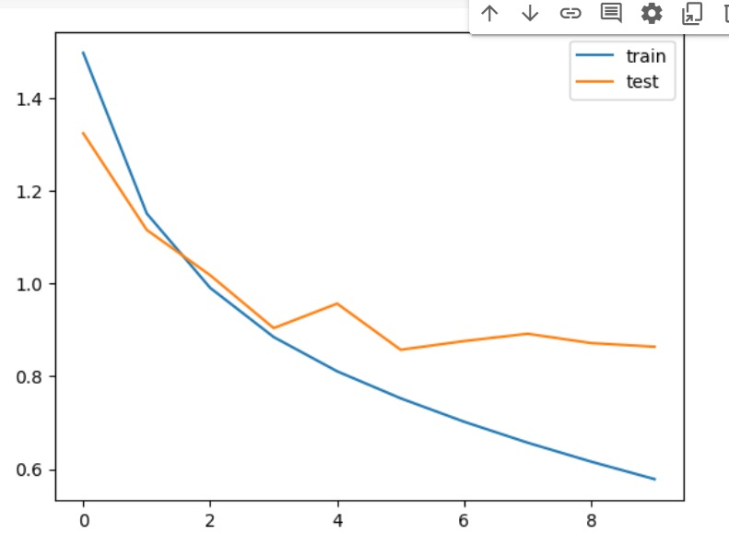
RESULT
Demo link:
https://github.com/Mohana-Priyak/TNSDC-Generative-AI-for-Engineering/blob/main/cat_recognition.ipynb

Slide 14
CONCLUSION
In conclusion, developing a CNN model for cat recognition involves several key steps, including data collection, preprocessing, model architecture design, training, evaluation, and deployment. By following these steps, we can create an effective model capable of accurately classifying cat images. Through experimentation, fine-tuning, and iterative refinement, we can optimize the model's performance and ensure its robustness in real-world scenarios. Continuous monitoring and updates based on feedback and evaluation results are essential for maintaining the model's effectiveness over time. Ultimately, a well-developed CNN model for cat recognition can have various applications, from pet monitoring systems to animal welfare initiatives, contributing to advancements in computer vision technology.

